Slide 1

GROUP 4 TESTING OF HARDWARE Project Title: Car Overspeed Detection System
Submitted By: Govind Raj(C0753448)

Slide 2

TESTING EACH HARDWARE PARTS
TESTING BEAGLEBONE BLACK
TESTING 16*2 LCD
TESTING IR SENSOR AND BUZZER
TESTING BLUETOOTH MODULE
TESTING ESP8266 WIFI MODULE
TESTING RELAY AND BULB
TESTING VOLTAGE REGULATOR

Slide 3
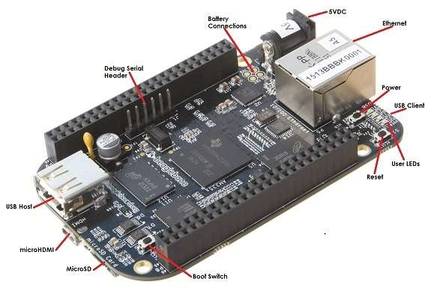
TESTING OF BEAGLEBONE BLACK
Connect beaglebone black to laptop using micro USB cable
Open terminal and login to debain using "ssh debian@192.168.7.2" as username and "temppwd" as password.
Use "ls" command to see the files inside beaglebone black
"uname –a" command can be used to check the linux version

Slide 4
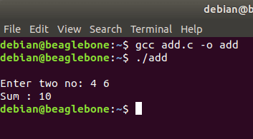
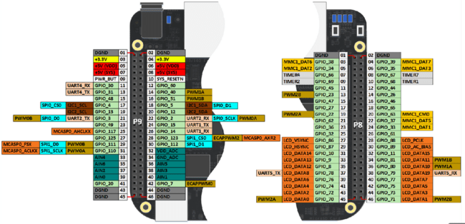
Writing code using nano editor and compiling it by gcc compiler worked fine
Figure aside shows the pinout of beaglebone balck

Slide 5
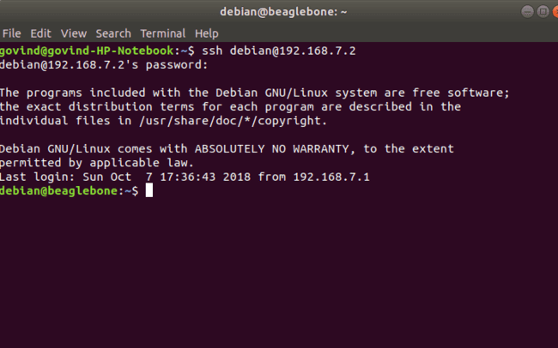
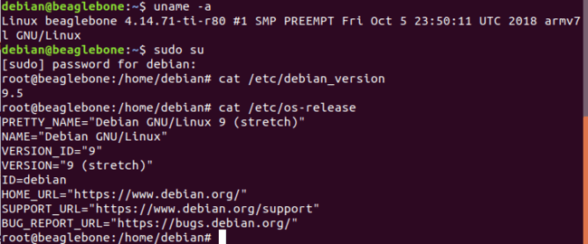
Screen after being logged into beaglebone black
Uname –a gives the Linux kernel version installed
Figure on right side shows the debian version

Slide 6
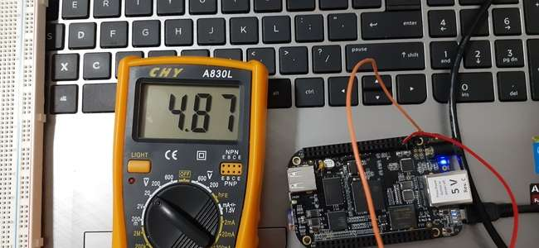
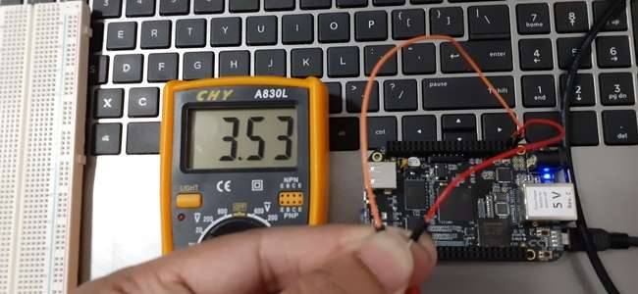
Tested and verified voltage VDD 3.3V(P9_3 and P9_4) and SYS 5V(P9_7 and P9_8)
SYS 5V pin(7 and 8)
VDD 3.3V pin(3 and 4)

Slide 7
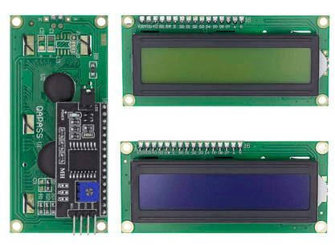
TESTING 16x2 LCD DISPLAY
Testing of 16x2 LCD was done using an Arduino uno.
PCF8574 module is used with lcd to connect lcd to Arduino using I2C protocol.
Contrast of lcd can be adujusted with the
potentiometer connected to PCF8574.
Connections:
LCD | Arduino
GND | GND
VCC | 5V
SDA | A4
SCL | A5

Slide 8
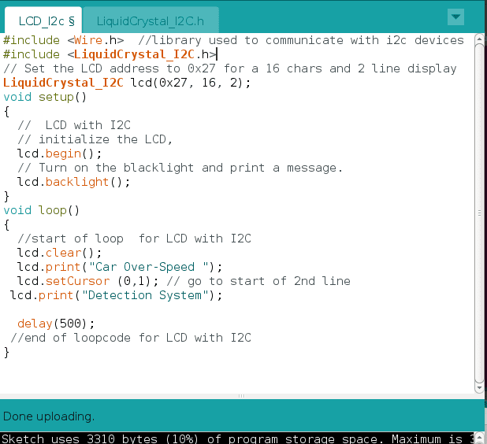
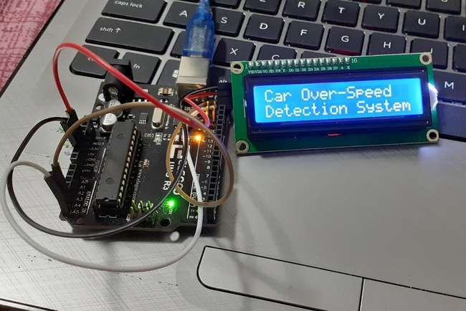
Written a simpe code for display "Car over-speed detection system" in LCD using PCF8574 module.

Slide 9
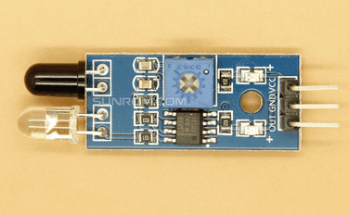
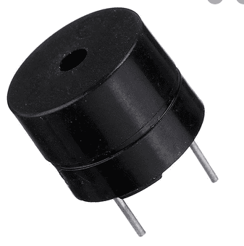
TESTING IR SENSOR AND BUZZER
IR sensor connected to Arduino uno.
GND pin connected to GND of Arduino ,VCC of IR sensor connected to 5V of Arduino, OUT pin of IR sensor connected to pin 7 of Arduino.
Buzzer connected to pin 13 of Arduino
Buzzer makes sounds when obstacle blocks IR sensor thus confirmed that IR sensor and buzzer is working fine.

Slide 10
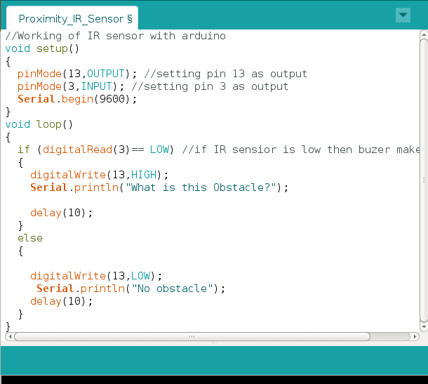
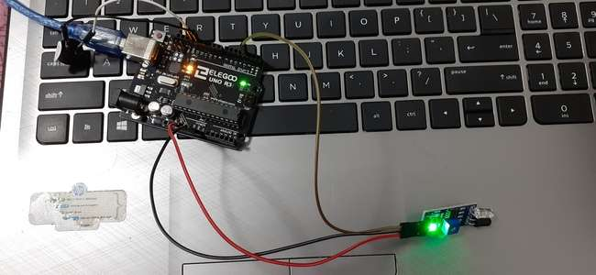
Below shown is simple code which used for testing IR sensor and buzzer that makes sound when some obstacle is nearby

Slide 11
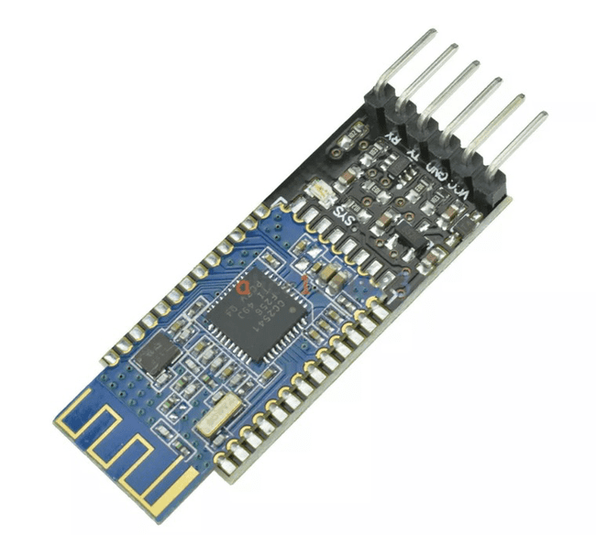
TESTING BLUETOOTH 4.0 MODULE
Shows testing of HM-10 BLE module
Bluetooth module is connected to arduino
An LED is connected as output.
Connections:
HM-10 BLE | Arduino
GND | GND
VCC | 3.3V
TX | PIN_2
RX | PIN_3

Slide 12
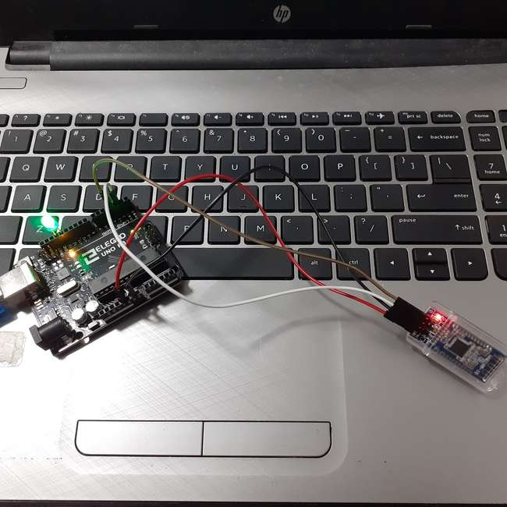
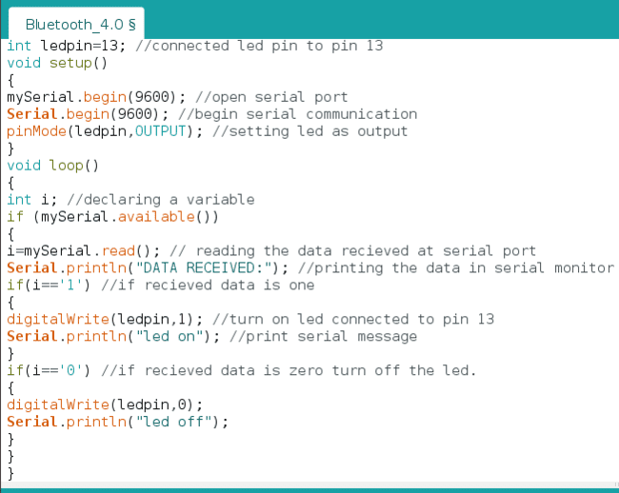
Added a small code for testing Bluetooth module.
Android application installed on mobile connected to Bluetooth module is used to turn off and on the LED.

Slide 13
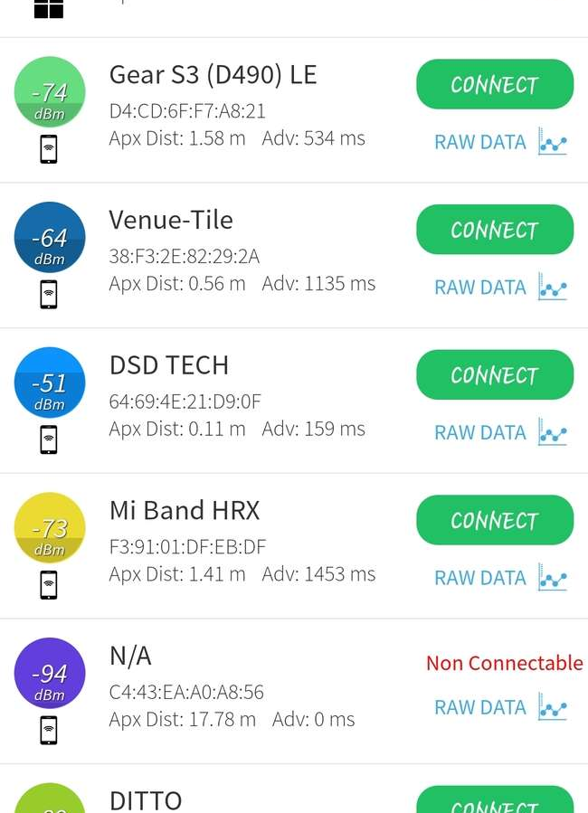

BLE Scanner bluetooth andriod application is used here to turn on and off the led via bluetooth.
After enabling bluetooth in phone and opening the application we can see th following interface.
Click on "CONNECT" beside DSD TECH

Slide 14
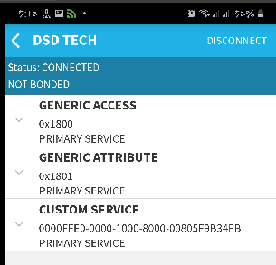
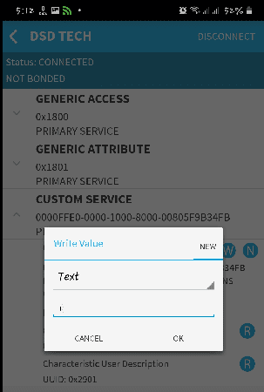
After clicking connect from main page of application we can see the interface as shown in figure 1.1
Click on custom service and write the number '1' as in figure 1.3
We can see the LED connected to arduino turned on as in figure 1.2.
Figure 1.1
Figure 1.3
Figure 1.2

Slide 15
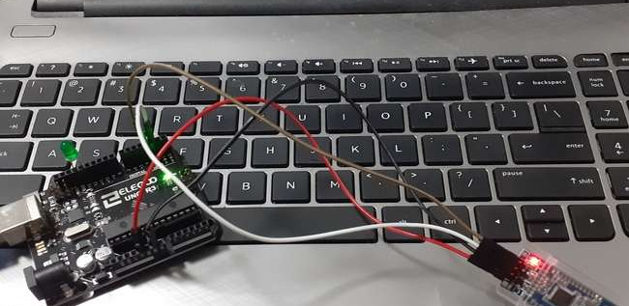
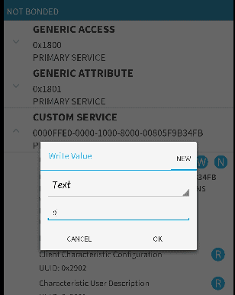
To turn off the led we can write '0' and click ok.

Slide 16
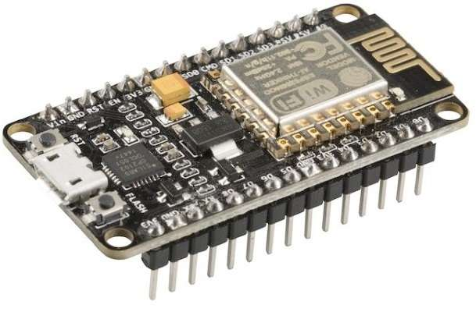
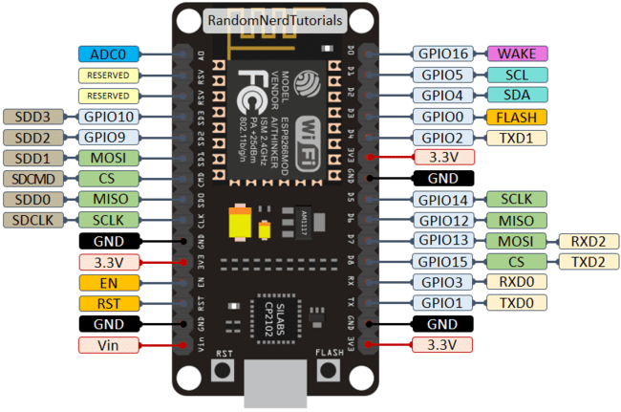
TESTING ESP8266 WIFI MODULE
ESP8266 is a wifi SOC made by expressif Systems. Provide internet connectivity to small package
The GPIO pins allow Analog and Digital IO , SPI, I2C, etc.
ESP8266 –12E wifi module is used for testing
Arduino IDE is used for programming ESP8266
Common data cable for phone charging is here for connecting esp8266 to laptop

Slide 17
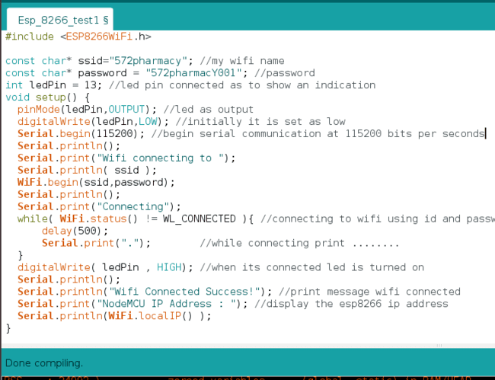
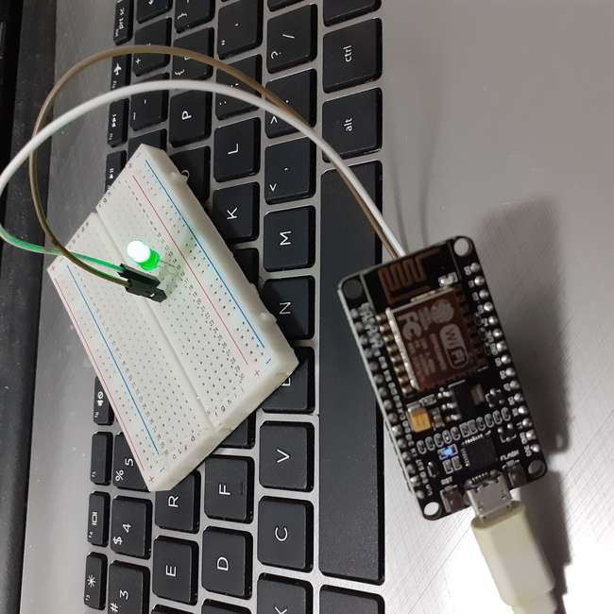
Written a small code for testing esp8266 module that lights up an led when wifi is connected.

Slide 18
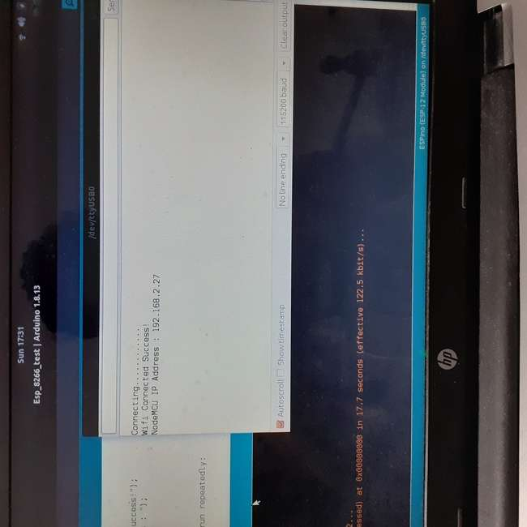
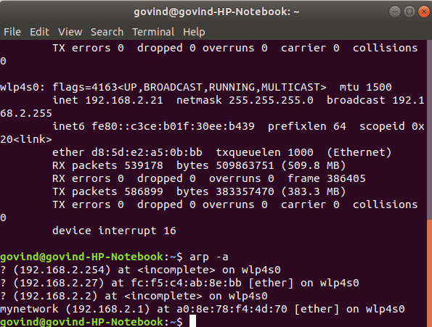
After uploading the code using arduino ide we can see the ouput in serial monitor as show in figure 1.2
Figure 1.1 below shows ip address of all devices connected to my home wifi in which I can see nodeMCU ip address.
Figure 1.1
Figure 1.2

Slide 19
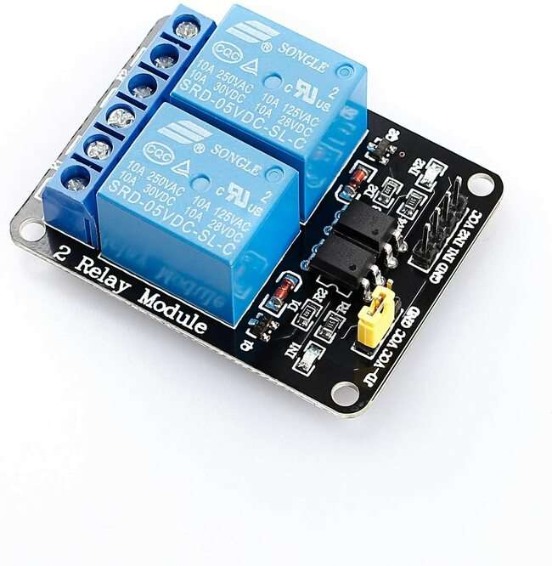
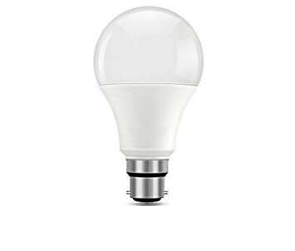
TESTING RELAY AND BULB
Testing of 5V relay and 12V DC bulb
Relay act as a switch that can controlled by a circuit.
Bulb is connected to 12v battery via relay
Relay is operated from Arduino Uno

Slide 20
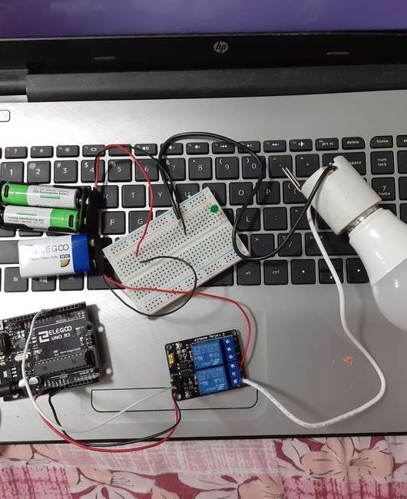
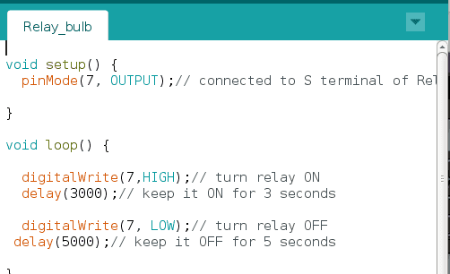
One 9v and two 1.5v battery is connected in series to operate this circuit
Relay works depending upon the arduino program
A simple program to blink an led is written for testing of both relay and bulb.

Slide 21
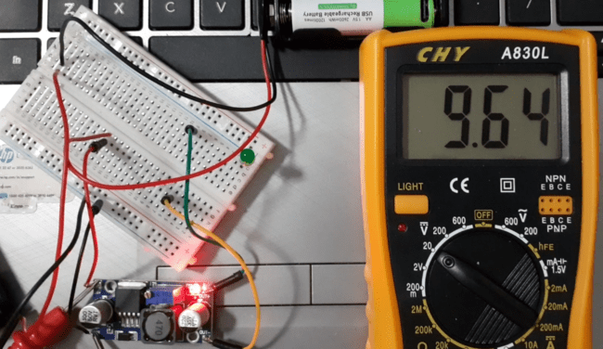
TESTING VOLTAGE REGULATOR
Voltage regulators can be found in many electronic devices
DC voltage regulator is used to increase or decrease the input voltage as our need.
2v –37v input
Figure shows LM2596 voltage regulator which is has given a input of 9.64v.

Slide 22
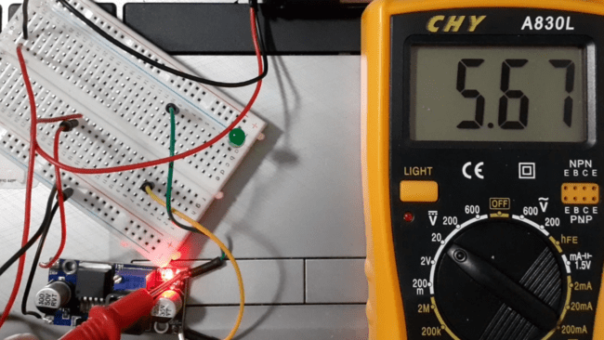
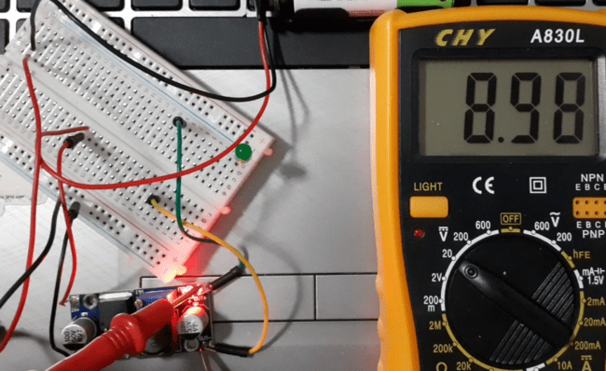
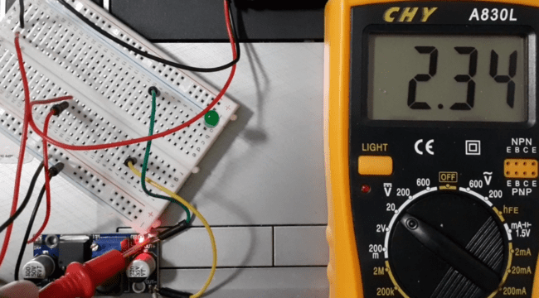
Input voltage decreased to 5.67v by turning potentiometer
Input voltage decreased to 8.98v
Input voltage decreased to 2.34v

Slide 23
REFERENCE
Sharma,A(2018, dec 05).Lcd I2C tutorial. Retrieved from https://create.arduino.cc/projecthub/Oniichan_is_ded/lcd-i2c-tutorial-664e5a
Sharath(n.d.). IR Proximity sensor with arduino. Retrieved from https://www.factoryforward.com/ir-proximity-sensor-arduino/
Ramya(2019, sept 04). Bluetooth Low Energy Tutorial with HM-10 BLE 4.0 & Arduino. Retrieved from https://how2electronics.com/bluetooth-low-energy-tutorial-with-hm-10-ble-4-0-arduino/
Tutor, M(2017, nov 20). NodeMCU ESP8266 Wifi connect tutorial Retrieved from https://www.youtube.com/watch?v=TnWDlHpY56o

